Slide 1
Mining Frequent Itemsets Using the Vertical Data Format

Slide 2
Both the Apriori and FP-growth methods
TID-itemset format (i.e., {TID : itemset}), where TID is a transaction ID and itemset is the set of items bought in transaction TID.
This is known as the horizontal data format.
Alternatively, data can be presented in item-TID set format
which is the essence of the Eclat (Equivalence Class Transformation) algorithm.

Slide 3
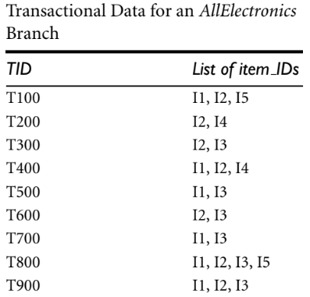
Mining frequent itemsets using the vertical data format
The minimum support count is 2.
Table-1

Slide 4
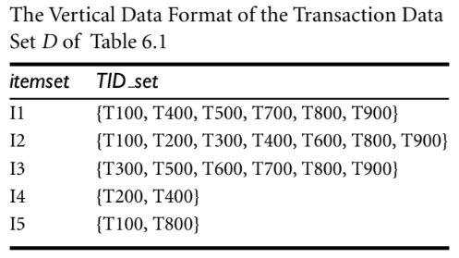
This can be transformed into the vertical data format by scanning the data set once.
Table- 2

Slide 5
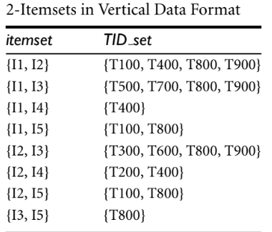
Mining can be performed on this data set by intersecting the TID sets of every pair of frequent single items.
Every single item is frequent in Table 2, there are 10 intersections performed in total, which lead to eight nonempty 2-itemsets,
Notice that because the itemsets {I1, I4} and {I3, I5} each contain only one transaction, they do not belong to the set of frequent 2-itemsets.

Slide 6
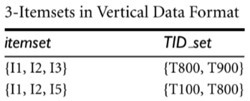
Based on the Apriori property, a given 3-itemset is a candidate 3-itemset only if every one of its 2-itemset subsets is frequent.
The candidate generation process here will generate only two 3-itemsets: {I1, I2, I3} and {I1, I2, I5}.
By intersecting the TID sets of any two corresponding 2-itemsets of these candidate 3-itemsets,where there are only two frequent 3-itemsets: {I1, I2, I3: 2} and {I1, I2, I5: 2}.

Slide 7
Summary
First, we transform the horizontally formatted data into the vertical format by scanning the data set once.
The support count of an itemset is simply the length of the TID set of the itemset.
Starting with k = 1, the frequent k-itemsets can be used to construct the candidate (k + 1)-itemsets based on the Apriori property.
The computation is done by intersection of the TID sets of the frequent k-itemsets to
compute the TID sets of the corresponding (k + 1)-itemsets.
This process repeats, with k incremented by 1 each time, until no frequent itemsets or candidate itemsets can be found.

Slide 8
Another merit of this method
There is no need to scan the database to find the support of (k + 1)-itemsets (for k ≥ 1).
This is because the TID set of each k-itemset carries the complete information required for counting such support.
However, the TID sets can be quite long, taking substantial memory space as well as computation time for intersecting the long sets.

Slide 9
diffset
keeps track of only the differences of the TID sets of a (k + 1)-itemset and a corresponding k-itemset.
It is used to further reduce the cost of registering long TID sets, as well as the subsequent costs of intersections

Slide 10
Example
For instance, if we have
{I1} = {T100, T400, T500, T700, T800, T900} and
{I1,I2} = {T100, T400, T800, T900}.
The diffset between the two is diffset({I1, I2}, {I1}) = {T500, T700}.
Thus, rather than recording the four TIDs that make up the intersection of {I1} and {I2}, we can instead use diffset to record just two TIDs, indicating the difference between {I1} and {I1, I2}.

Slide 11
Experiments show that in certain situations this technique can substantially reduce the total cost of mining of frequent itemsets
when the data set contains many dense and long patterns

